Slide 1
Cascading Style Sheets (CSS): Part II

Slide 2
Outline
Introduction
Text Shadows
Rounded Corners
Color
Box Shadows
Linear Gradients and Radial Gradients
Multiple Background Images
Image Borders
Animation; Selectors
Transitions and Transformations

Slide 3
Downloading Web Fonts and the @font-face Rule
Flexible Box Layout Module and
:nth-child Selectors
Multicolumn Layout
Media Queries

Slide 4
Introduction
In the preceding chapter we presented “traditional” CSS capabilities.
In this chapter, we introduce many features new to CSS3.
These capabilities are being built into the browsers, resulting in faster and more economical web development and better client-side performance.
This reduces the need for JavaScript libraries and sophisticated graphics software packages such as Adobe Photoshop, Adobe Illustrator, Corel PaintShop Pro and Gimp to create interesting effects.

Slide 5
Text Shadows
The CSS3 text-shadow property makes it easy to add a text shadow effect to any text
The property has four values:
-4px, 4px, 6px and green, which represent:
Horizontal offset of the shadow—A negative value moves the text-shadow to the left; a positive value moves it to the right.
Vertical offset of the shadow—A negative value moves the shadow up, whereas a positive value moves it down.
blur radius—the blur (in pixels) of the shadow. A blur-radius of 0px would result in a shadow with a sharp edge (no blur). The greater the value, the greater the blurring of the edges. We used a blur radius of 6px.
color—determines the color of the text-shadow.
Example: textshadow.html

Slide 6
Rounded Corners
The border-radius property allows you to add rounded corners to an element (Fig. 5.2).
In this example, we create two rectangles with solid Navy borders. For the first rectangle,
we set the border-radius to 15px (line 17). This adds slightly rounded corners to the rectangle.
For the second rectangle, we increase the border-radius to 50px (line 27), making the left and right sides completely round.
Any border-radius value greater than half of the shortest side length produces a completely round end.
You can also specify the radius for each corner with
border-top-left-radius, border-top-right-radius,
border-bottom-left-radius and border-bottom-right-radius
Example: roundedcorners.html

Slide 7
Color
CSS3 allows you to express color in several ways in addition to standard color names (such as Aqua) or hexadecimal RGB values (such as #00FFFF for Aqua).
RGB (Red, Green, Blue) or RGBA (Red, Green, Blue, Alpha) gives you greater control over the exact colors in your web pages.
The value for each color—red, green and blue—can range from 0 to 255.
The alpha value—which represents opacity—can be any value in the range 0.0 (fully transparent) through 1.0 (fully opaque).

Slide 8
CSS3 also allows you to express color using HSL (hue, saturation, lightness) or HSLA (hue, saturation, lightness, alpha) values.
The hue is a color or shade expressed as a value from 0 to 359 representing the degrees on a color wheel (a wheel is 360 degrees).
The saturation— the intensity of the hue—is expressed as a percentage, where 100% is fully saturated (the full color) and 0% is gray.
Lightness—the intensity of light or luminance of the hue— is also expressed as a percentage.
A lightness of 50% is the actual hue. If you decrease the amount of light to 0%, the color appears completely dark (black). If you increase the amount of light to 100%, the color appears completely light (white).

Slide 9
Box Shadows
You can shadow any block-level element in CSS3.
We add the box-shadow property with four values:
Horizontal offset of the shadow — A positive value moves the box-shadow to the right, A negative value moves the box-shadow to the left
Vertical offset of the shadow — A positive value moves the box-shadow down, A negative value moves the box-shadow up.
Blur radius—A blur-radius of 0px would result in a shadow with a sharp edge (no blur). The greater the value, the more the edges of the shadow are blurred.
Color—the box-shadow’s color.
Example: boxshadow.html

Slide 10
CSS prefixes
The most common browser CSS prefixes you will see in older code bases include:
-webkit- (Chrome, Safari, newer versions of Opera and Edge, almost all iOS browsers including Firefox for iOS; basically, any WebKit or Chromium-based browser)
-moz- (Firefox)
-o- (old pre-WebKit versions of Opera)
-ms- (Internet Explorer and Microsoft Edge, before Chromium)

Slide 11
Linear Gradients
Linear gradients are a type of image that gradually transitions from one color to the next horizontally, vertically or diagonally.
You can transition between as many colors as you like and specify the points at which to change colors, called color-stops, represented in pixels or percentages along the gradient line—the angle at which the gradient extends.
You can use gradients in any property that accepts an image.
Vertical Linear Gradient
Horizontal Linear Gradient
Diagonal Linear Gradient
Example: lineargradient.html

Slide 12
Radial Gradients
Radial gradients are similar to linear gradients, but the color changes gradually from an inner point (the start) to an outer circle (the end).
gradient property has three values
Position ( center, top, bottom, left and right)
start color and
end color .
Example: radialgradient.html

Slide 13
Multiple Background Images
CSS3 allows you to add multiple background images to an element.
The comma-separated list of values matches the order of the comma-separated list of images in the background-image property.
Example: multiplebackgrounds.html

Slide 14
Image Borders
The CSS3 border-image property uses images to place a border around any block-level element (Fig. 5.10).
In line 12, we set a div’s border-width to 30px, which is the thickness of the border we’re placing around the element.
Next, we specify a width of 234px, which is the width of the entire rectangular border.
Stretching an Image Border
In this example, we create two image border styles.
In the first (lines 16–22), we stretch (and thus distort) the sides of the image to fit around the element while leaving the corners of the border image unchanged (not stretched).

Slide 15
The border-image property has six values:
border-image-source—the URL of the image.
border-image-slice—expressed with four space-separated values in pixels.
border-image-repeat—specifies how the regions of the border image are scaled and tiled (repeated)

Slide 16
Repeating an Image Border
In lines 23–29 we create an image border by repeating the regions to fit the space.
The border-image property includes four values:
border-image-source—the URL of the image to use in the border (once again, url(border.png)).
border-image-slice—in this case, we provided two values expressed in percentages (34% 34%) for the top/bottom and left/right, respectively.
border-image-repeat—the value repeat specifies that the tiles are repeated to fit the area, using partial tiles to fill the excess space.
Example: imageborder.html

Slide 17
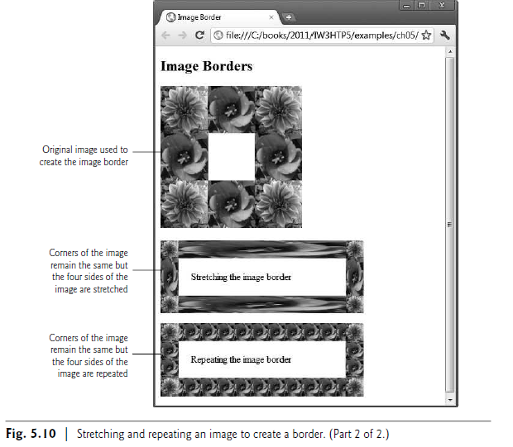

Slide 18
Animation; Selectors
The animation property allows you to represent several animation properties in a shorthand notation, rather than specifying each separately, as in:
animation-name: movingImage;
animation-timing-function: linear;
animation-duration: 10s;
animation-delay: 1s;
animation-iteration-count: 2;
animation-direction: alternate;
Example: animation.html

Slide 19
Transitions and Transformations
With CSS3 transitions, you can change an element’s style over a specified duration—
For example, you can vary an element’s opacity from opaque to transparent over a duration of one second.
CSS3 transformations allow you to move, rotate, scale and skew elements.
transition: transform 4s;
Example: transitions.html
skew.html

Slide 20
DownloadingWeb Fonts and the @font-face Rule
Using the @font-face rule, you can specify fonts for a web page, even if they’re not installed on the user's system.
You can use downloadable fonts to help ensure a uniform look across client sites.
In Fig. 5.15, we use the Google web font named “Calligraffitti.”
You can find numerous free, open-source web fonts at http://www.google.com/webfonts.
Make sure the fonts you get from other sources have no legal encumbrances
Example: embeddedfonts.html

Slide 21
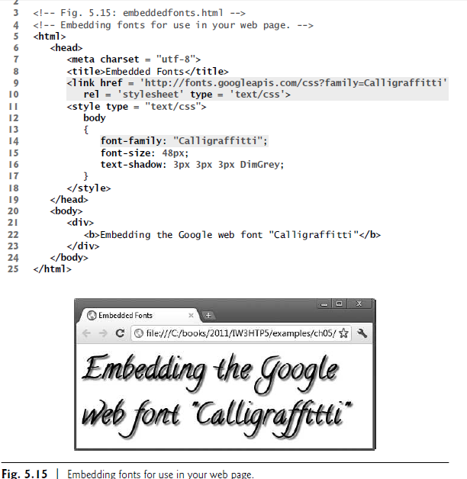

Slide 22
Flexible Box Layout Module and :nth-child Selectors
Flexible Box Layout Module (FBLM) makes it easy to align the contents of boxes, change their size, change their order dynamically, and lay out the contents in any direction.
Example: fblm.html

Slide 23
Multicolumn Layout
CSS3 allows you to easily create multicolumn layouts.
In Figure 5.17, we create a three column layout by setting the column-count property to 3 (lines 15–18) and the column gap property (the spacing between columns) to 30px (lines 20-23).
We then add a thin black line between each column using the column-rule property.
Example: multicolumns.html

Slide 24
Media Queries
With CSS media types (Section 4.11), you can vary your styling based on the type of device on which your page is being presented.
The classic examples are varying font styles and sizes, based on whether a page is printed or displayed on a screen.
Users generally prefer sans-serif fonts on screens and serif fonts on paper.
With CSS3 media queries you can determine the finer attributes of the media on which the user is viewing the page, such as the length and width of the viewing area on the screen, to better customize your presentation.
Example: mediaqueries.html

